Slide 1
Memory Technology
Topics
  Memory Hierarchy Basics
  Static RAM
  Dynamic RAM
  Magnetic Disks
  Access Time Gap
class17.ppt

Slide 2
Computer System
Processor
Reg
Cache
Memory-I/O bus
I/O
controller
I/O
controller
I/O
controller
Memory
Display
Network
Disk
Disk

Slide 3
Levels in Memory Hierarchy
cache
virtual memory
CPU
C
a
c
h
e
Memory
8 B
32 B
8 KB
disk
regs
Register
Cache
Memory
Disk Memory
size:
speed:
$/Mbyte:
block size:
200 B
2 ns
8 B
32KB - 4MB
4 ns
$100/MB
32 B
128 MB
60 ns
$1.50/MB
8 KB
20 GB
8 ms
$0.05/MB
larger, slower, cheaper

Slide 4
Scaling to 0.1µm
  Semiconductor Industry Association, 1992 Technology Workshop
    Projected future technology based on past trends
1992 1995 1998 2001 2004 2007
Feature size: 0.5 0.35 0.25 0.18 0.12 0.10
  Industry is slightly ahead of projection
DRAM capacity: 16M 64M 256M 1G 4G 16G
  Doubles every 1.5 years
  Prediction on track
Chip area (cm²): 2.5 4.0 6.0 8.0 10.0 12.5
  Way off! Chips staying small

Slide 5
Static RAM (SRAM)
Fast
  ~4 nsec access time
Persistent
  as long as power is supplied
  no refresh required
Expensive
  ~$100/MByte
  6 transistors/bit
Stable
  High immunity to noise and environmental disturbances
Technology for caches

Slide 6
Anatomy of an SRAM Cell
bit line
bit line
Stable Configurations
b
b’
word line
0
1
1
0
Terminology:
bit line: carries data
word line: used for addressing
(6 transistors)
Write:
  1. set bit lines to new data value
    b’ is set to the opposite of b
  2. raise word line to “high”
  ⇒ sets cell to new state (may involve flipping relative to old state)
Read:
1. set bit lines high
  2. set word line high
  3. see which bit line goes low

Slide 7
SRAM Cell Principle
Inverter Amplifies
  Negative gain
  Slope < –1 in middle
  Saturates at ends
Inverter Pair Amplifies
  Positive gain
  Slope > 1 in middle
  Saturates at ends
1
0.9
0.8
0.7
0.6
0.5
0.4
V1
V2
0.3
Vin
0.2
V1
0.1
0
0
0.2
0.4
0.6
0.8
1
V2
Vin

Slide 8
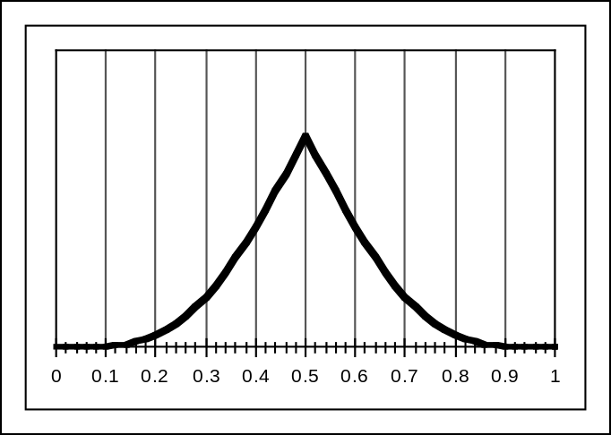
Bistable Element
Vin
Stability
  Require Vin = V2
  Stable at endpoints
    recover from pertubation
  Metastable in middle
    Fall out when perturbed
Ball on Ramp Analogy
V1
V2
1
Stable
0.9
0.8
0.7
0.6
Metastable
0.5
Vin
0.4
V2
0.3
0.2
0.1
0
0
0.2
0.4
0.6
0.8
1
Stable
Vin

Slide 9
Example SRAM Configuration (16 x 8)
b7
b7’
b1
b1’
b0
b0’
W0
Address
decoder
A0
W1
A1
memory
cells
A2
A3
W15
R/W
sense/write
amps
sense/write
amps
sense/write
amps
Input/output lines
d7
d1
d0

Slide 10
Dynamic RAM (DRAM)
Slower than SRAM
  access time ~60 nsec
Nonpersistant
  every row must be accessed every ~1 ms (refreshed)
Cheaper than SRAM
  ~$1.50 / MByte
  1 transistor/bit
Fragile
  electrical noise, light, radiation
Workhorse memory technology

Slide 11
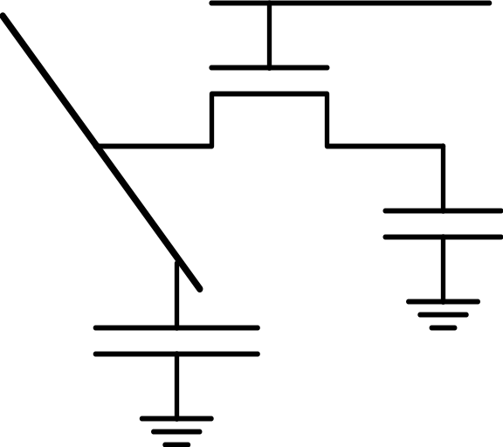
Anatomy of a DRAM Cell
Word Line
Bit
Line
Storage Node
Access
Transistor
C_{node}
C_{BL}
Writing
Reading
Word Line
Word Line
Bit Line
V
Bit Line
Storage Node
ΔV ~ C_{node} / C_{BL}

Slide 12
Addressing Arrays with Bits
Array Size
  R rows, R = 2^{r}
  C columns, C = 2^{c}
  N = R * C bits of memory
Addressing
  Addresses are n bits, where N = 2^{n}
  row(address) = address / C
    leftmost r bits of address
  col(address) = address % C
    rightmost bits of address
Example
  R = 2
  C = 4
  address = 6
r
c
address =
row
col
n
0 1 2 3
0 000 001 010 011
1 100 101 110 111
row 1
col 2

Slide 13
Example 2-Level Decode DRAM (64Kx1)
RAS
256 Rows
Row
decoder
256x256
cell array
Row
address
latch
8
\
row
A7-A0
256 Columns
column
sense/write
amps
R/W’
col
Provide 16-bit address in two 8-bit chunks
Column
address
latch
8
column
latch and
decoder
\
CAS
Dout
Din

Slide 14
DRAM Operation
Row Address (~50ns)
  Set Row address on address lines & strobe RAS
  Entire row read & stored in column latches
  Contents of row of memory cells destroyed
Column Address (~10ns)
  Set Column address on address lines & strobe CAS
  Access selected bit
    READ: transfer from selected column latch to Dout
    WRITE: Set selected column latch to Din
Rewrite (~30ns)
  Write back entire row

Slide 15
Observations About DRAMs
Timing
  Access time (= 60ns) < cycle time (= 90ns)
  Need to rewrite row
Must Refresh Periodically
  Perform complete memory cycle for each row
  Approximately once every 1ms
  Sqrt(n) cycles
  Handled in background by memory controller
Inefficient Way to Get a Single Bit
  Effectively read entire row of Sqrt(n) bits

Slide 16
Enhanced Performance DRAMs
Conventional Access
  Row + Col
  RAS CAS RAS CAS ...
Page Mode
  Row + Series of columns
  RAS CAS CAS CAS ...
  Gives successive bits
Other Acronyms
  EDORAM
    “Extended data output”
  SDRAM
    “Synchronous DRAM”
RAS
Row
decoder
256x256
cell array
Row
address
latch
8
\
row
A7-A0
sense/write
amps
R/W’
col
Column
address
latch
8
column
latch and
decoder
\
CAS
Entire row buffered here
Typical Performance
row access time col access time cycle time page mode cycle time
50ns 10ns 90ns 25ns

Slide 17
Video RAM
Performance Enhanced for Video / Graphics Operations
  Frame buffer to hold graphics image
Writing
  Random access of bits
  Also supports rectangle fill operations
    Set all bits in region to 0 or 1
Reading
  Load entire row into shift register
  Shift out at video rates
Performance Example
  1200 X 1800 pixels / frame
  24 bits / pixel
  60 frames / second
  2.8 GBits / second
256x256
cell array
column
sense/write
amps
Shift Register
Video Stream Output

Slide 18
DRAM Driving Forces
Capacity
  4X per generation
    Square array of cells
  Typical scaling
    Lithography dimensions 0.7X
      Areal density 2X
    Cell function packing 1.5X
    Chip area 1.33X
  Scaling challenge
    Typically C_{node} / C_{BL} = 0.1–0.2
    Must keep C_{node} high as shrink cell size
Retention Time
  Typically 16–256 ms
  Want higher for low-power applications

Slide 19
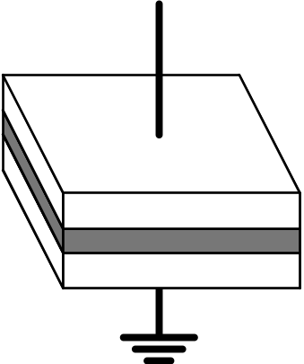
DRAM Storage Capacitor
Planar Capacitor
  Up to 1Mb
  C decreases linearly with feature size
Trench Capacitor
  4–256 Mb
  Lining of hole in substrate
Stacked Cell
  > 1Gb
  On top of substrate
  Use high ε dielectric
Plate
Area A
Dielectric Material
Dielectric Constant ε
d
C = εA/d

Slide 20
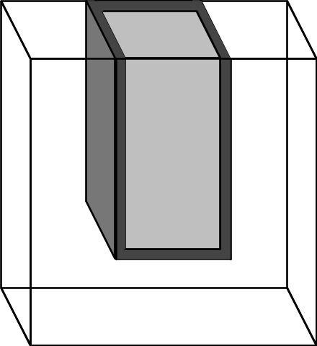
Trench Capacitor
Process
  Etch deep hole in substrate
    Becomes reference plate
  Grow oxide on walls
    Dielectric
  Fill with polysilicon plug
    Tied to storage node
SiO₂ Dielectric
Storage Plate
Reference Plate

Slide 21
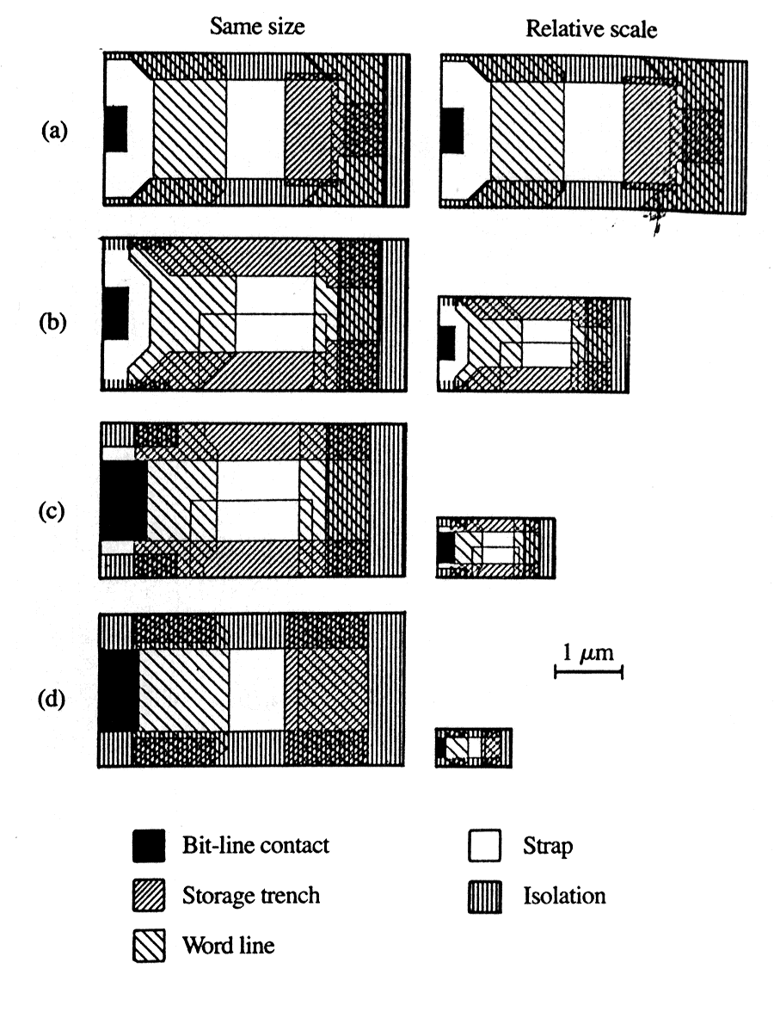
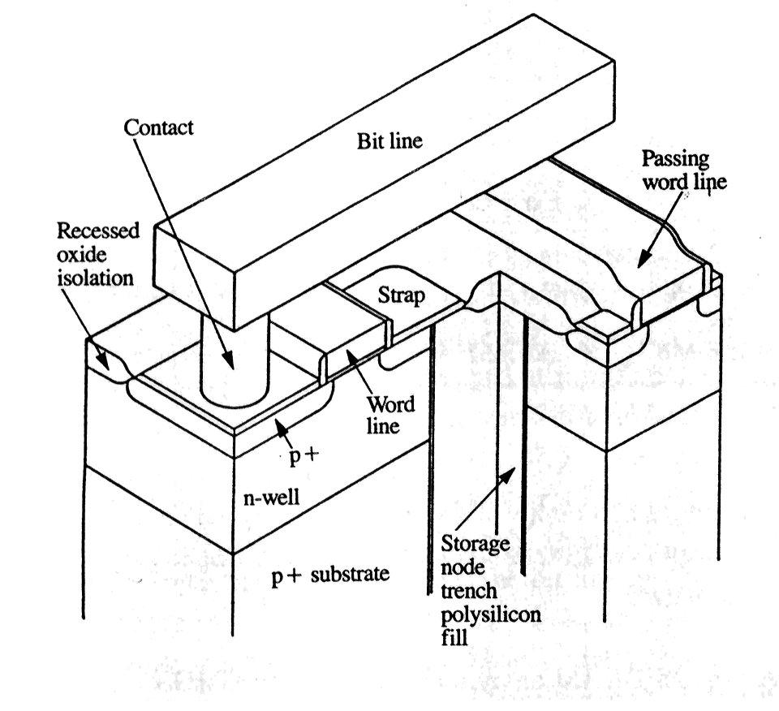
IBM DRAM Evolution
  IBM J. R&D, Jan/Mar ‘95
  Evolution from 4 – 256 Mb
  256 Mb uses cell with area 0.6 µm²
Cell Layouts
4Mb
4 Mb Cell Structure
16Mb
64Mb
256Mb

Slide 22
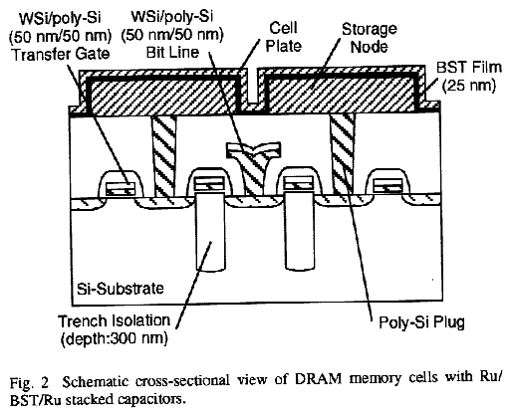
Mitsubishi Stacked Cell DRAM
  IEDM ‘95
  Claim suitable for 1 – 4 Gb
Technology
  0.14 µm process
    Synchrotron X-ray source
  8 nm gate oxide
  0.29 µm² cell
Storage Capacitor
  Fabricated on top of everything else
  Rubidium electrodes
  High dielectric insulator
    50X higher than SiO₂
    25 nm thick
  Cell capacitance 25 femtofarads
Cross Section of 2 Cells

Slide 23
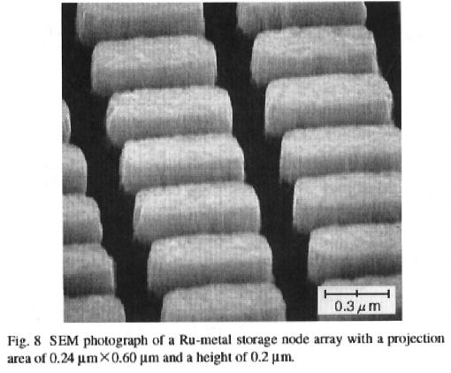
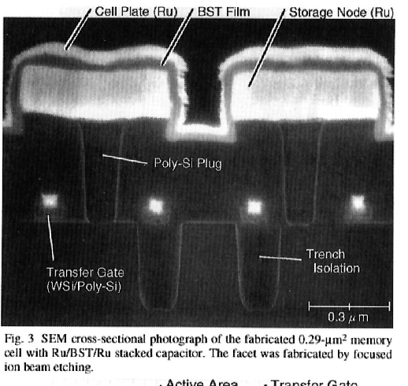
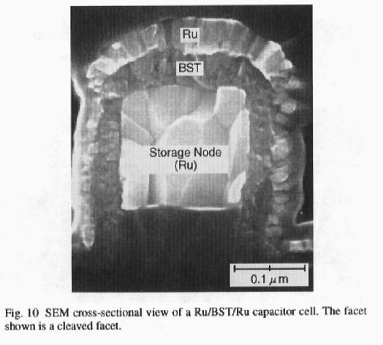
Mitsubishi DRAM Pictures

Slide 24
Magnetic Disks
Disk surface spins at
3600–7200 RPM
read/write head
arm
The surface consists
of a set of concentric
magnetized rings called tracks
The read/write head floats over the disk surface and moves back and forth on an arm from track to track.
Each track is divided
into sectors

Slide 25
Disk Capacity
Parameter 18GB Example
  Number Platters 12
  Surfaces / Platter 2
  Number of tracks 6962
  Number sectors / track 213
  Bytes / sector 512
Total Bytes 18,221,948,928

Slide 26
Disk Operation
Operation
  Read or write complete sector
Seek
  Position head over proper track
  Typically 6-9ms
Rotational Latency
  Wait until desired sector passes under head
  Worst case: complete rotation
    10,025 RPM ⇒ 6 ms
Read or Write Bits
  Transfer rate depends on # bits per track and rotational speed
  E.g., 213 * 512 bytes @10,025RPM = 18 MB/sec.
  Modern disks have external transfer rates of up to 80 MB/sec
    DRAM caches on disk help sustain these higher rates

Slide 27
Disk Performance
Getting First Byte
  Seek + Rotational latency = 7,000 – 19,000 µsec
Getting Successive Bytes
  ~ 0.06 µsec each
    roughly 100,000 times faster than getting the first byte!
Optimizing Performance:
  Large block transfers are more efficient
  Try to do other things while waiting for first byte
    switch context to other computing task
    processor is interrupted when transfer completes

Slide 28
Disk / System Interface
1. Processor Signals Controller
  Read sector X and store starting at memory address Y
2. Read Occurs
  “Direct Memory Access” (DMA) transfer
  Under control of I/O controller
3. I/O Controller Signals Completion
  Interrupts processor
  Can resume suspended process
(1) Initiate Sector Read
Processor
Reg
(3) Read Done
Cache
Memory-I/O bus
(2) DMA Transfer
I/O
controller
Memory
Disk
Disk

Slide 29
Magnetic Disk Technology
Seagate ST-12550N Barracuda 2 Disk
  Linear density 52,187. bits per inch (BPI)
    Bit spacing 0.5 microns
  Track density 3,047. tracks per inch (TPI)
    Track spacing 8.3 microns
  Total tracks 2,707. tracks
  Rotational Speed 7200. RPM
  Avg Linear Speed 86.4 kilometers / hour
  Head Floating Height 0.13 microns
Analogy:
  put the Sears Tower on its side
  fly it around the world, 2.5cm above the ground
  each complete orbit of the earth takes 8 seconds

Slide 30
CD Read Only Memory (CDROM)
Basis
  Optical recording technology developed for audio CDs
    74 minutes playing time
    44,100 samples / second
    2 X 16-bits / sample (Stereo)
    ⇒ Raw bit rate = 172 KB / second
  Add extra 288 bytes of error correction for every 2048 bytes of data
    Cannot tolerate any errors in digital data, whereas OK for audio
Bit Rate
  172 * 2048 / (288 + 2048) = 150 KB / second
    For 1X CDROM
    N X CDROM gives bit rate of N * 150
    E.g., 12X CDROM gives 1.76 MB / second
Capacity
  74 Minutes * 150 KB / second * 60 seconds / minute = 650 MB

Slide 31
Storage Trends
metric 1980 1985 1990 1995 2000 2000:1980
$/MB 19,200 2,900 320 256 100 190
access (ns) 300 150 35 15 2 100
SRAM
metric 1980 1985 1990 1995 2000 2000:1980
$/MB 8,000 880 100 30 1.5 5,300
access (ns) 375 200 100 70 60 6
typical size(MB) 0.064 0.256 4 16 64 1,000
DRAM
metric 1980 1985 1990 1995 2000 2000:1980
$/MB 500 100 8 0.30 0.05 10,000
access (ms) 87 75 28 10 8 11
typical size(MB) 1 10 160 1,000 9,000 9,000
Disk
(Culled from back issues of Byte and PC Magazine)

Slide 32
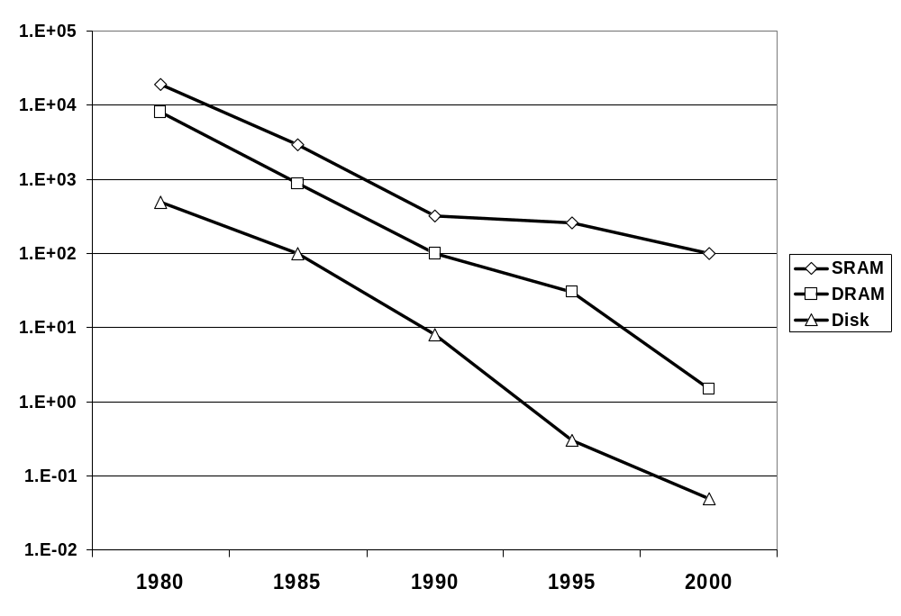
Storage Price: $/MByte

Slide 33
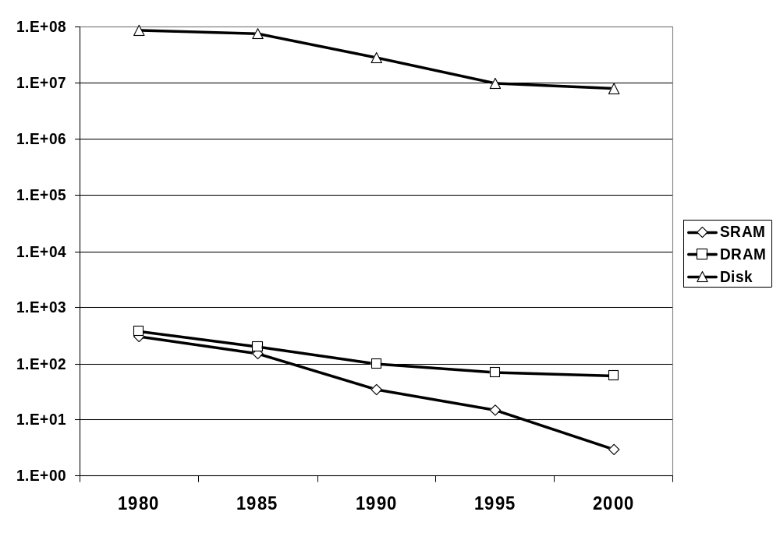
Storage Access Times (nsec)

Slide 34
Processor clock rates
Processors
metric 1980 1985 1990 1995 2000 2000:1980
typical clock(MHz) 1 6 20 150 600 600
processor 8080 286 386 Pentium P-III
culled from back issues of Byte and PC Magazine

Slide 35
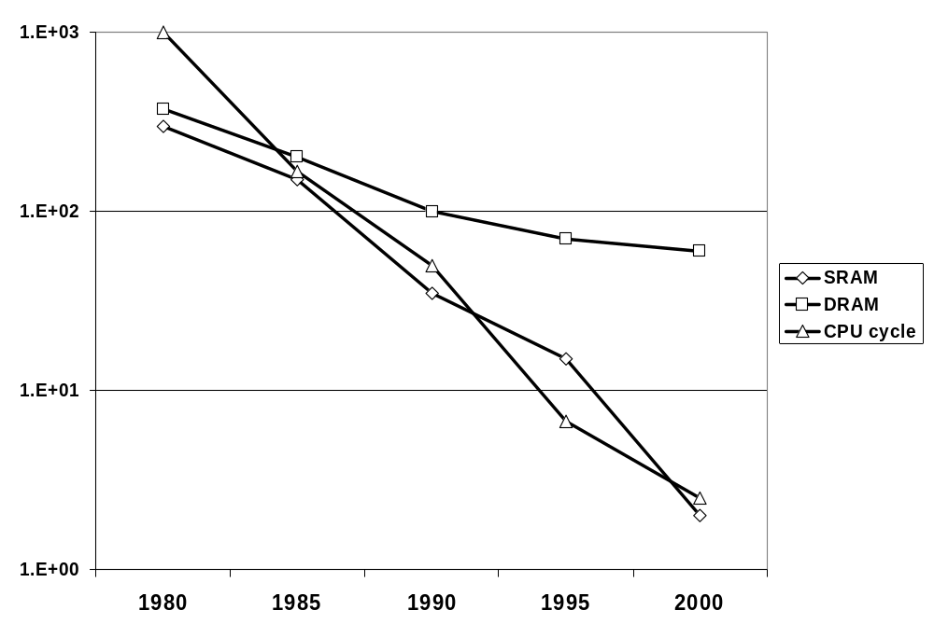
The CPU vs. DRAM Latency Gap (ns)

Slide 36
Memory Technology Summary
Cost and Density Improving at Enormous Rates
Speed Lagging Processor Performance
Memory Hierarchies Help Narrow the Gap:
  Small fast SRAMS (cache) at upper levels
  Large slow DRAMS (main memory) at lower levels
  Incredibly large & slow disks to back it all up
Locality of Reference Makes It All Work
  Keep most frequently accessed data in fastest memory

